Slide 1
DBMS Project Group 11
ID | Name
1821161 | Choudhury Ben Yamin Siddiqui
2022101 | Sihab Saharier
1710290 | Miftahul Karim Wriddhy
2030692 | Md. Nawez Sharif
2010651 | Towsif Islam
1931404 | Asif Jobair

Slide 2
Introduction
As our project topic was to develop a Web Application to help with communication between Patient, Doctors and Health Care Providers, we tried to develop a system that will allow patients and doctors to communicate through online with appointments.

Slide 3
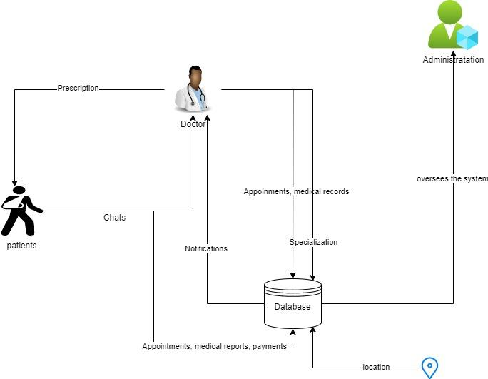
AS_IS Rich Picture

Slide 4
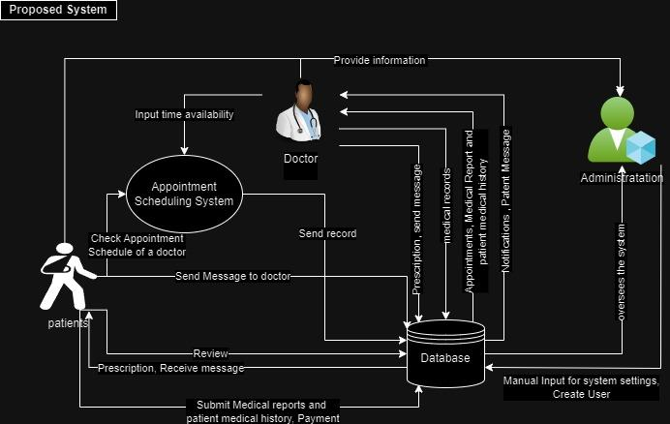
To Be Rich Picture

Slide 5
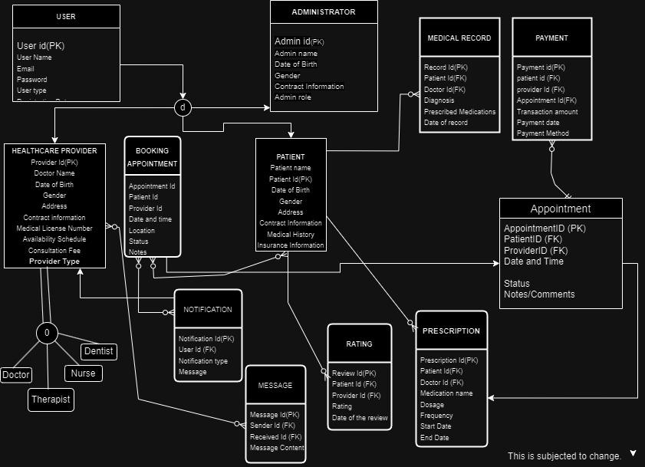
Enhanched Entity Relation Diagram

Slide 6
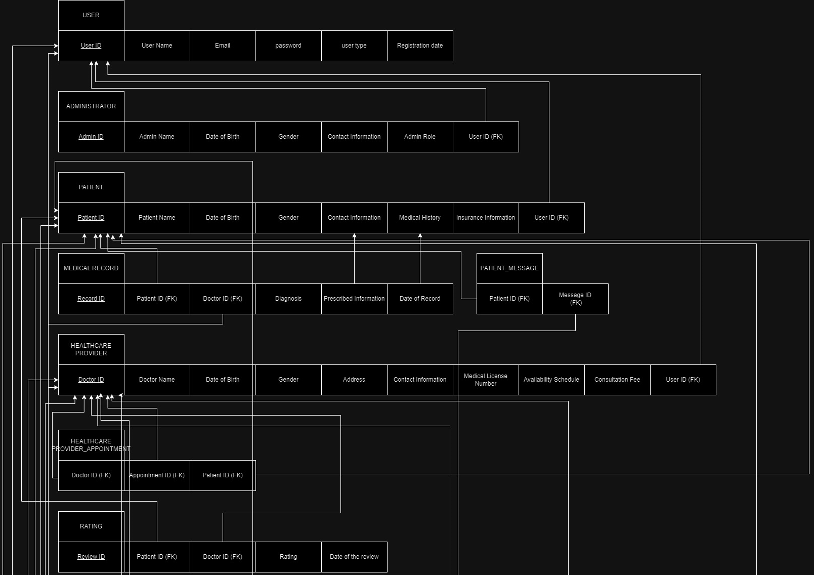
Relation Schema (Part 1)

Slide 7
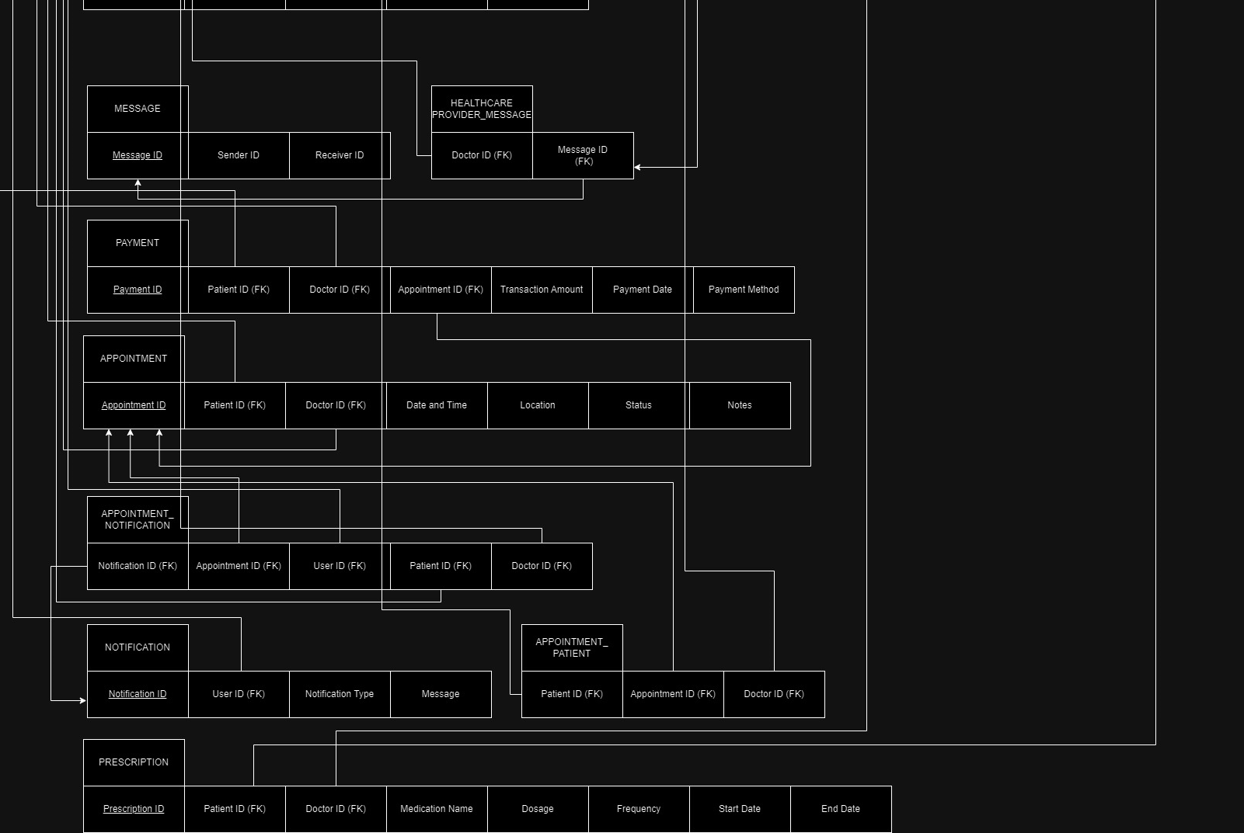
Relation Schema (Part 2)

Slide 8
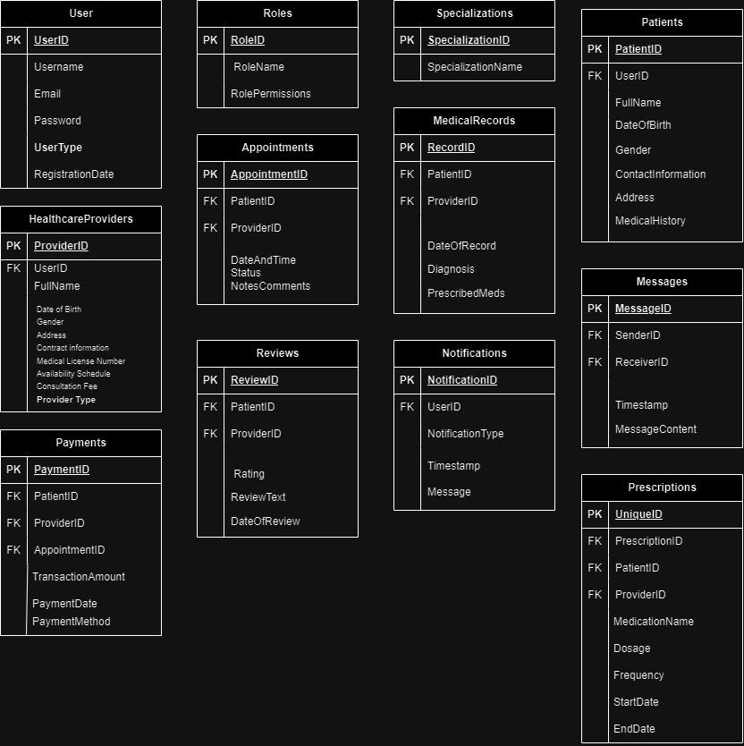
Normalized Schema

Slide 9
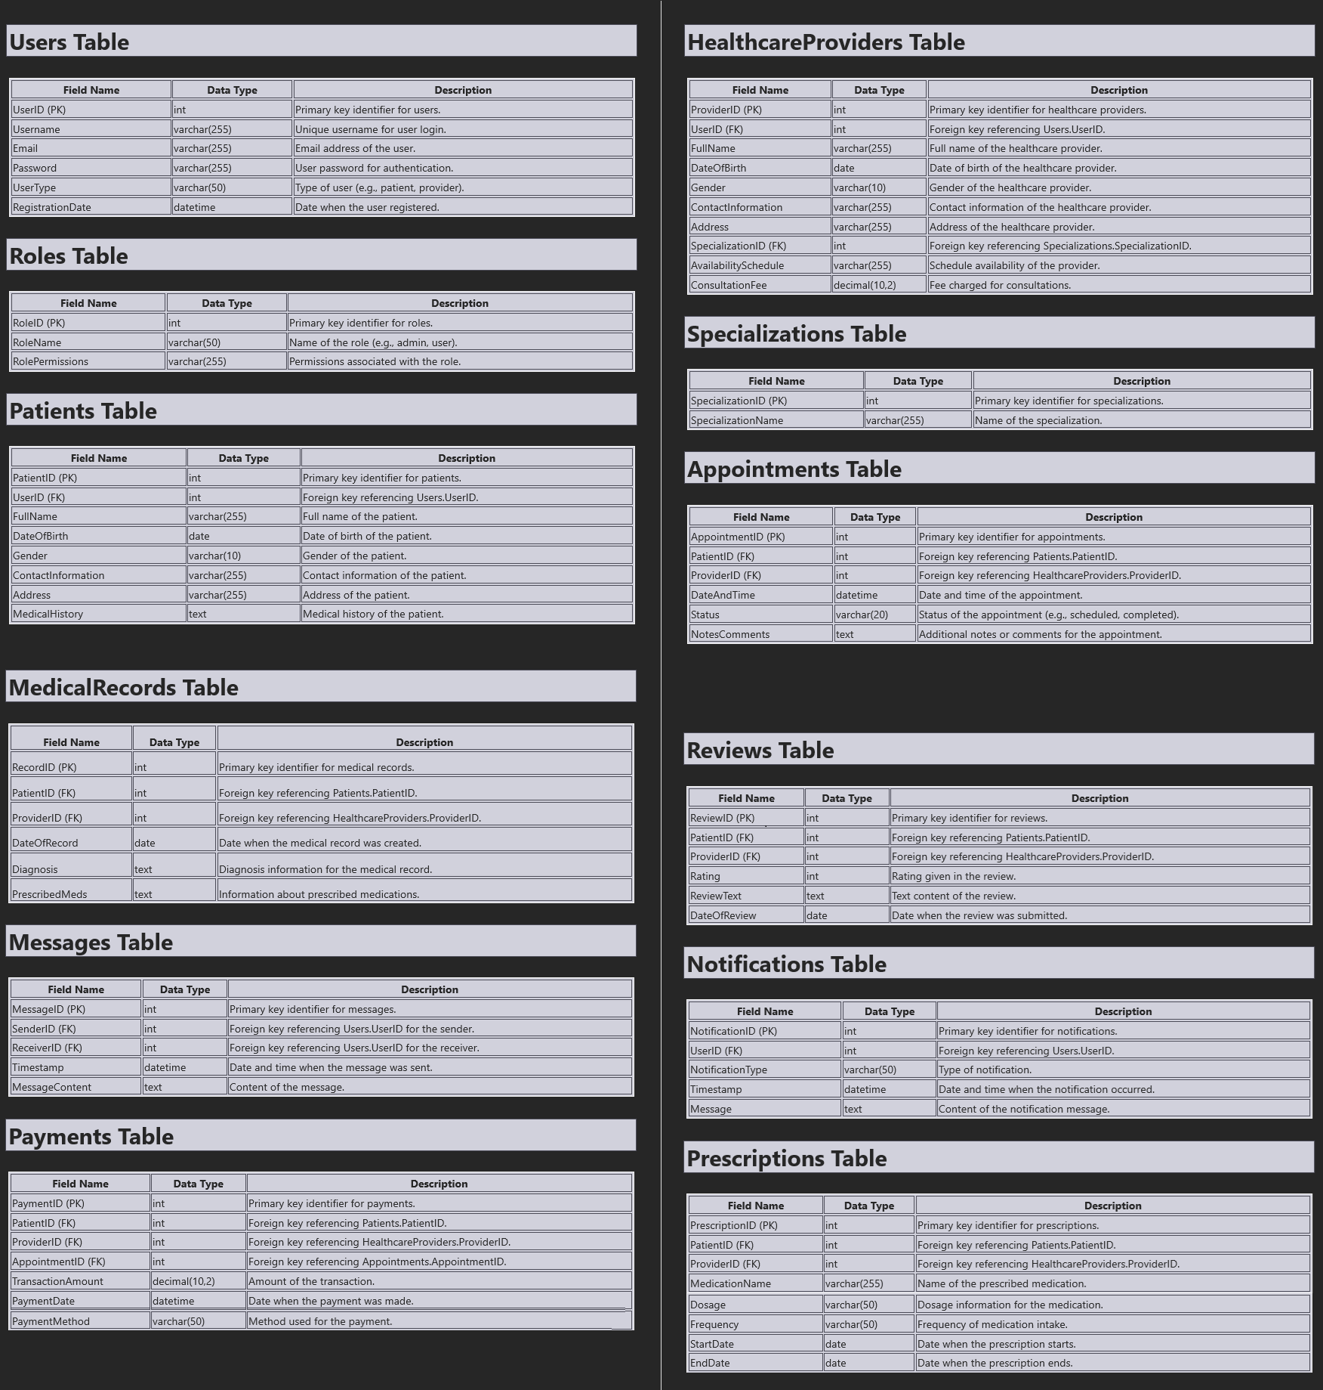
Database Table

Slide 10
The END

